Slide 1
FAT 12 File Format
(2016-11-09)

Slide 2
The FAT File System
Files are stored on the disk as linked clusters
A cluster maps to one or more sectors (defined in boot sector)
Directories are arrays of binary records
Root directory stored in reserved sectors
Subdirectories stored in files within cluster space
Directory entries store only the first cluster of file
The rest of the file is linked in the FAT
File Allocation Table
Disk
0
1
2
4
3
5
4
14
Directory
5
8
6
EOF
7
9
8
18
Foo
3
9
10
FooBaby
2
10
11
FooBar
7
11
EOF
Fooy
12
12
17
13
15
14
6
15
16
16
EOF
17
13
18
EOF
19
Notes:
(Look at BYTE SectorsPerCluster) not 512 bytes
#define SizeOfSector 512
cluster = SizeOfSector * SizeOfCluster

Slide 3

Disk Structure
Sector 0: Boot Sector
Sector 1: First sector of first FAT
Sector 10: First sector of second FAT
Sector 19: First sector of root directory
Sector 32: Last sector of root directory
Check boot sector for root directory length
Sector 33: First sector of data area
Boot | FAT Tables |  |  |  |  |  |  |  |  |  |  |  |  |  |  |  |  |  | Root Directory (14 sectors × 16 entries/sector = 224 entries) |  |  |  |  |  |  |  |  |  |  |  |  |  | File Clusters 2 - 2849
 | FAT 1 |  |  |  |  |  |  |  |  | FAT 2 |  |  |  |  |  |  |  |  |  |  |  |  |  |  |  |  |  |  |  |  |  |  | Data Area…
0 | 1 | 2 | 3 | 4 | 5 | 6 | 7 | 8 | 9 | 10 | 11 | 12 | 13 | 14 | 15 | 16 | 17 | 18 | 19 | 20 | 21 | 22 | 23 | 24 | 25 | 26 | 27 | 28 | 29 | 30 | 31 | 32 | 33 - 2880
Notes:
Root Directory limited to 14 sectors – limits the number of files on a disk at the root directory level (limited to 252 files)
(Look at WORD MaxRootEntries)
This is defined at format disk time
Windows stores in clusters (which may be multiple sectors)

Slide 4
Boot Sector
BYTE = 8 bits
WORD = 16 bits
DWORD = 32 bits
#pragma pack(push, 1) /* Byte align in memory (no padding) */
typedef struct
{ unsigned char BS_jmpBoot[3]; /* Jump instruction to the boot code */ unsigned char BS_OEMName[8]; /* Name of system that formatted the volume */ unsigned short BPB_BytsPerSec; /* Bytes per sector (should be 512) */ unsigned char BPB_SecPerClus; /* Sectors per cluster (FAT-12 = 1) */ unsigned short BPB_RsvdSecCnt; /* Reserved sectors (FAT-12 = 1) */ unsigned char BPB_NumFATs; /* FAT tables on the disk (should be 2) */ unsigned short BPB_RootEntCnt; /* Max directory entries in root directory */ unsigned short BPB_TotSec16; /* FAT-12 total number of sectors on the disk */ unsigned char BPB_Media; /* Media type {fixed, removable, etc.} */ unsigned short BPB_FATSz16; /* Sector size of FAT table (FAT-12 = 9) */ unsigned short BPB_SecPerTrk; /* # of sectors per cylindrical track */ unsigned short BPB_NumHeads; /* # of heads per volume (1.4Mb 3.5" = 2) */ unsigned long BPB_HiddSec; /* # of preceding hidden sectors (0) */ unsigned long BPB_TotSec32; /* # of FAT-32 sectors (0 for FAT-12) */ unsigned char BS_DrvNum; /* A drive number for the media (OS specific) */ unsigned char BS_Reserved1; /* Reserved space for Windows NT (set to 0) */ unsigned char BS_BootSig; /* (0x29) Indicates following: */ unsigned long BS_VolID; /* Volume serial # (for tracking this disk) */ unsigned char BS_VolLab[11]; /* Volume label (RDL or "NO NAME ") */ unsigned char BS_FilSysType[8]; /* Deceptive FAT type Label */
} BSStruct;
#pragma pack(pop) /* End strict alignment */

Slide 5
File Allocation Table
FAT
0
1
2 | 4
3 | 5
4 | 14
5 | 8
6 | EOF
7 | 9
8 | 18
9 | 10
10 | 11
11 | EOF
12 | 17
13 | 15
14 | 6
15 | 16
16 | EOF
17 | 13
18 | EOF
19
Directory
File Name
Start
foo
3
0
1
2
3
3
foobaby
2
4
5
6
7
5
foobar
7
8
8
9
10
11
fooy
12
12
13
14
15
16
18
19
17
18
End of File

Slide 6
Directories
Array of directory entries
Root directory has a fixed number of entries
14 reserved sectors
14 sectors × 16 entries/sector = 224 entries
Contiguous sectors
Referenced when cDir = 0
Subdirectories are simply files in cluster space
Same directory structure within each sector
Directory entry
32 bytes
Filename’s first character is usage indicator
0x00 Never been used (End of directory)
0xe5 Used before but entry has been deleted
Notes:
14 x 512 x 32 = 224 files stored in root directory
14 sectors x 512 bytes/sector x 32 bytes/directory entry
What happens when I fill up this disk with little sectors then delete them. Will I get back the same amount of free space?
No! Windows does not reclaim empty subdirectory sectors.
However, deleting subdirectories would recover the space.
Allows undelete to work

Slide 7
Directory Entry
#pragma pack(push, 1) /* Byte align in memory (no padding) */
typedef struct
{ unsigned char Name[8]; /* File name (capital letters, padded w/spaces) */ unsigned char Extension[3]; /* Extension (same format as name, no '.') */ unsigned char Attributes; /* Holds the attributes code */ unsigned char Reserved[10]; /* Reserved for Windows NT (Set to zero!) */ unsigned short Time; /* Time of last write */ unsigned short Date; /* Date of last write */ unsigned short startCluster; /* Pointer to the first cluster of the file */ unsigned long fileSize; /* File size in bytes */
} DirEntry;
#pragma pack(pop) /* End strict alignment */
Notes:
Filename and Extension are NOT C-strings – not null terminated.
The only characters in these fields are characters, numbers, and SPACES!
Thus, cannot use string compare for finding file names.
Use FOR loops to compare (8 then 3).
Take disk with long file names and look at the directory.

Slide 8
Directory Attributes
8 directory attributes
Bit Mask Attribute
0 0x01 Read Only
1 0x02 Hidden
2 0x04 System
3 0x08 Volume Label
4 0x10 Subdirectory
5 0x20 Archive
6 0x40 Unused
7 0x80 Unused
Long file names
Be essentially transparent on earlier versions of MS-DOS.
Be located in close proximity, on the media, to the short directory entry.
Disk maintenance utilities are not to jeopardize the integrity of existing file data.
Solution: Precede short directory entry with long name.
ATTR_LONG_NAME = ATTR_READ_ONLY | ATTR_HIDDEN | ATTR_SYSTEM | ATTR_VOLUME_ID
= 0x0f

Slide 9
Date/Time Bit Fields
#pragma pack(push,1) // BYTE align in memory (no padding)
typedef struct
{ // (total 16 bits--a unsigned short)
unsigned short sec: 5; // low-order 5 bits are the seconds
unsigned short min: 6; // next 6 bits are the minutes
unsigned short hour: 5; // high-order 5 bits are the hour
} FATTime;
#pragma pack(pop) // End of strict alignment
#pragma pack(push,1) // BYTE align in memory (no padding)
typedef struct
{ // (total 16 bits--a unsigned short)
unsigned short day: 5; // low-order 5 bits are the day
unsigned short month: 4; // next 4 bits are the month
unsigned short year: 7; // high-order 7 bits are the year
} FATDate;
#pragma pack(pop) // End of strict alignment

Slide 10
Directory Example
c:\lcc\projects\disk1:\lc-3>dir
Name:ext time date cluster size
. ----D- 14:09:42 02/23/2004 2 0
.. ----D- 14:09:42 02/23/2004 0 0
README.TXT -----A 14:15:36 02/23/2004 117 147
HEX ----D- 14:12:46 02/23/2004 84 0
SOURCE ----D- 14:13:06 02/23/2004 85 0
c:\lcc\projects\disk1:\lc-3>ds 33
Sector 33:
0x00004200: 2e 20 20 20 20 20 20 20 20 20 20 10 00 18 34 71 . ..↑4q
0x00004210: 57 30 57 30 00 00 35 71 57 30 02 00 00 00 00 00 W0W0..5qW0......
0x00004220: 2e 2e 20 20 20 20 20 20 20 20 20 10 00 18 34 71 .. ..↑4q
0x00004230: 57 30 57 30 00 00 35 71 57 30 00 00 00 00 00 00 W0W0..5qW0......
0x00004240: 41 52 00 65 00 61 00 64 00 6d 00 0f 00 73 65 00 AR.e.a.d.m...se.
0x00004250: 2e 00 74 00 78 00 74 00 00 00 00 00 ff ff ff ff ..t.x.t.........
0x00004260: 52 45 41 44 4d 45 20 20 54 58 54 20 00 7e f0 71 README TXT .~.q
0x00004270: 57 30 57 30 00 00 f2 71 57 30 75 00 93 00 00 00 W0W0...qW0u.....
0x00004280: e5 4d 00 65 00 6d 00 54 00 65 00 0f 00 68 73 00 .M.e.m.T.e...hs.
0x00004290: 74 00 2e 00 68 00 65 00 78 00 00 00 00 00 ff ff t...h.e.x.......
0x000042a0: e5 45 4d 54 45 53 54 20 48 45 58 20 00 62 78 71 .EMTEST HEX .bxq
0x000042b0: 57 30 57 30 00 00 30 b1 49 30 08 00 50 0a 00 00 W0W0..0.I0..P...
0x000042c0: e5 78 00 00 00 ff ff ff ff ff ff 0f 00 cc ff ff .x..............
0x000042d0: ff ff ff ff ff ff ff ff ff ff 00 00 ff ff ff ff ................
0x000042e0: e5 43 00 61 00 6c 00 63 00 75 00 0f 00 cc 6c 00 .C.a.l.c.u....l.
0x000042f0: 61 00 74 00 6f 00 72 00 2e 00 00 00 68 00 65 00 a.t.o.r.....h.e.
0x00004300: e5 41 4c 43 55 4c 7e 31 48 45 58 20 00 82 7b 71 .ALCUL~1HEX ..{q
0x00004310: 57 30 57 30 00 00 c9 74 3b 30 0e 00 1e 18 00 00 W0W0...t;0..▲↑..
0x00004320: e5 6d 00 00 00 ff ff ff ff ff ff 0f 00 06 ff ff .m..............
0x00004330: ff ff ff ff ff ff ff ff ff ff 00 00 ff ff ff ff ................
0x00004340: e5 43 00 61 00 6c 00 63 00 75 00 0f 00 06 6c 00 .C.a.l.c.u....l.
0x00004350: 61 00 74 00 6f 00 72 00 2e 00 00 00 61 00 73 00 a.t.o.r.....a.s.
0x00004360: e5 41 4c 43 55 4c 7e 31 41 53 4d 20 00 7c 83 71 .ALCUL~1ASM .|.q
0x00004370: 57 30 57 30 00 00 ef 74 3b 30 1b 00 12 71 00 00 W0W0...t;0←..q..
0x00004380: e5 4e 00 65 00 77 00 20 00 46 00 0f 00 dd 6f 00 .N.e.w. .F....o.
0x00004390: 6c 00 64 00 65 00 72 00 00 00 00 00 ff ff ff ff l.d.e.r.........
0x000043a0: e5 45 57 46 4f 4c 7e 31 20 20 20 10 00 74 96 71 .EWFOL~1 ..t.q
0x000043b0: 57 30 57 30 00 00 97 71 57 30 54 00 00 00 00 00 W0W0...qW0T.....
0x000043c0: 48 45 58 20 20 20 20 20 20 20 20 10 08 74 96 71 HEX ..t.q
0x000043d0: 57 30 57 30 00 00 97 71 57 30 54 00 00 00 00 00 W0W0...qW0T.....
0x000043e0: 53 4f 55 52 43 45 20 20 20 20 20 10 08 42 a2 71 SOURCE ..B.q
0x000043f0: 57 30 57 30 00 00 a3 71 57 30 55 00 00 00 00 00 W0W0...qW0U.....
c:\lcc\projects\disk1:\lc-3>
#pragma pack(push, 1)
typedef struct
{ unsigned char Name[8]; unsigned char Extension[3]; unsigned char Attributes; unsigned char Reserved[10]; unsigned short Time; unsigned short Date; unsigned short startCluster; unsigned long fileSize;
} DirEntry;
#pragma pack(pop)
Notes:
Filename and Extension are NOT C-strings – not null terminated.
The only characters in these fields are characters, numbers, and SPACES!
Thus, cannot use string compare for finding file names.
Use FOR loops to compare (8 then 3).
Take disk with long file names and look at the directory.

Slide 11

FAT Quiz #1

Slide 12
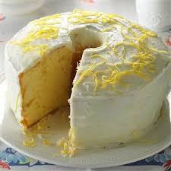

Wednesday, March 29, 2017
National Lemon Chiffon Cake Day
And it came to pass…
Presentations start Friday
Exam II 03/30 – 04/04
50 questions
Closed book
1 Sheet Handwritten Notes
No time limit
Homework #6 due 04/14
Project 6 – 2 parts
FAT I due April 13
FAT II due April 20
FAT, part 2

Slide 13
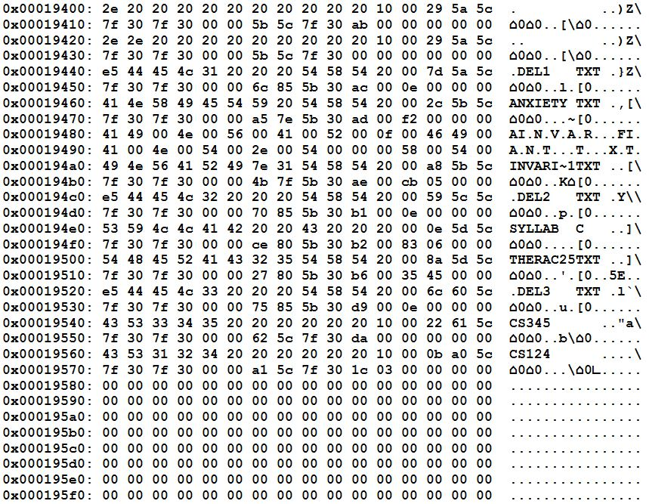
Deleted entry
Long File Name
8.3 Compliant
End-of-Directory

Slide 14
c:/lcc/projects/disk4:\>>dir
Name:ext time date cluster size
BIGDIR ----D- 11:31:40 04/31/2004 3 0
BYU ----D- 11:34:54 04/31/2004 171 0
JOKES ----D- 11:37:06 04/31/2004 800 0
LONGFI~1 ----D- 11:37:14 04/31/2004 875 0
PERSONAL ----D- 11:37:18 04/31/2004 937 0
TEMP ----D- 11:37:36 04/31/2004 1355 0
H2O.C -----A 19:00:02 03/12/2004 1380 3425
MAKE.TXT -----A 16:26:58 03/27/2004 1387 18584
c:/lcc/projects/disk4:\>>cd byu
c:/lcc/projects/disk4:\byu>>dir
Name:ext time date cluster size
. ----D- 11:34:54 04/31/2004 171 0
.. ----D- 11:34:54 04/31/2004 0 0
ANXIETY.TXT -----A 15:53:10 03/27/2004 173 242
INVARI~1.TXT -----A 15:58:22 03/27/2004 174 1483
SYLLAB.C -----A 16:06:28 03/27/2004 178 1667
THERAC25.TXT -----A 16:01:14 03/27/2004 182 17717
CS345 ----D- 11:35:04 04/31/2004 218 0
CS124 ----D- 11:37:02 04/31/2004 796 0

Slide 15

FAT Quiz #2

Slide 16
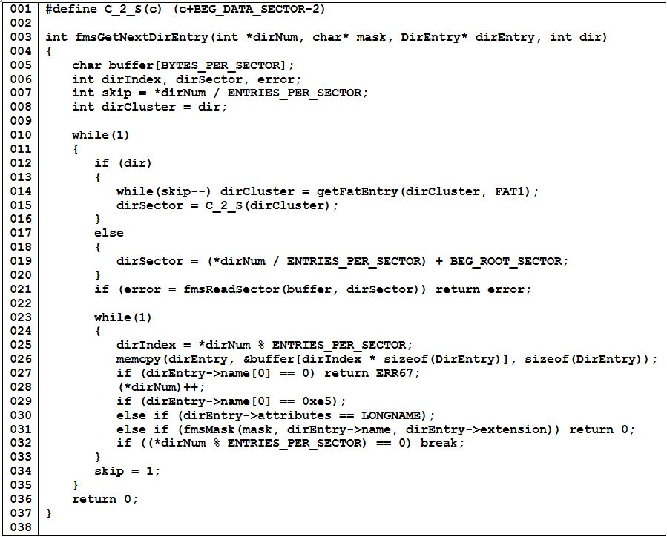

Slide 17
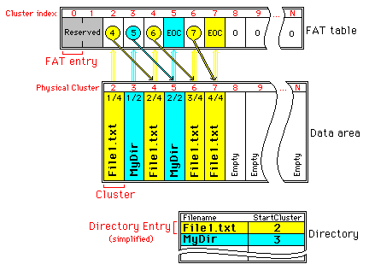
FAT-12
A₂ A₁
B₁ A₃
B₃ B₂
⇒ A₁A₂A₃ and B₁B₂B₃
Each FAT entry is 12 bits (byte and a half)
4096 possible blocks (2 entries in 3 bytes)
With 512 byte sectors, can represent 2 Mb (DD Floppy)
First 2 entries in the FAT are reserved
Don’t use
All linking is done in logical cluster numbers
Example FAT:
F0 FF FF 03 40 00 05 60 00 07 80 00 09 F0 FF
First 2 entries are reserved (3 bytes)
First file cluster is 2 (bytes 3 and 4)
03 40 00 → 003 and 004
FF8 – FFF indicates EOF

Slide 18
Project 6 – FAT File System

Slide 19
Project 6 – FMS I
RAM Disk Image: A FAT-12 disk image is loaded into a RAM disk (memory array) using a mount command and subsequently accessed by your file manager using read/write sector primitives. The RAM disk is divided into 2880 sectors, each being 512 bytes.
RAM Disk Files and Directories: A FAT-12 file system specifies how files are named, accessed, and stored in your RAM disk image. Your program will maintain a current directory (cDir) and be able to navigate hierarchal directories. File and directory names are at most 8 characters long, with an optional 3 character extension. Directory names may be preceded by 1 or more long file name directory entries.
Read/Write Sector: All accesses to the RAM disk memory array must be through the read/write sector functions! This would enable your project to easily be converted to use real physical disk devices.

Slide 20
FAT File Management Functions
Disk access (Provided)
int fmsReadSector(void* buffer, int sectorNumber );
int fmsWriteSector(void* buffer, int sectorNumber );
int fmsMount(char* fileName, void* ramDisk );
int fmsUnMount(char* fileName, void* ramDisk );
Directory traversal (Provided)
int fmsChangeDir(char* dirName);
int fmsGetNextDirEntry(int* dirNum, char* mask,
DirEntry* dirEntry, int cDir);

Slide 21
FAT File Management Functions
FAT – Part 1: Read-only file access (To be implemented)
int fmsOpenFile(char* fileName, int rwMode);
int fmsReadFile(int fileDescriptor, char* buffer, int nBytes);
int fmsCloseFile(int fileDescriptor);
FAT – Part 2: Write/Create/Delete files (To be implemented)
int fmsWriteFile(int fileDescriptor, char* buffer, int nBytes);
int fmsSeekFile(int fileDescriptor, int index);
int fmsDefineFile(char* filename, int attribute);
int fmsDeleteFile(char* fileName);

Slide 22
FMS CLI Commands
cd <file name/..> Change directory
chkdsk Check disk
copy <file1>,<file2> Copy file
define <file> Define file
delete <file name> Delete file
dir {<mask>} Display files in current directory
final {<#>} Test file manager
mkdir <dir name> Create directory
mount <file name> Initialize FAT-12 RAM disk
run <file name> Execute LC-3 program
sp Display bytes used/free/bad/size
type <file name> Display file
unmount <file name> Write FAT-12 RAM disk to file

Slide 23
Helper Commands
op <file name>{,<mode} Open File
rd <# bytes> Read (max=512)
Wr <# bytes> Write (max=52 A-z)
sk <index> Seek
cl <fileid> Close
fs Display open files
ds <sector #> Dump sector

Slide 24
FMS Errors
Error Code. Note: MUST BE USED FOR PASS-OFF!
-50 =
"Invalid File Name"
-67 =
"End-Of-Directory"
-51 =
"Invalid File Type"
-68 =
"Directory Not Found"
-52 =
"Invalid File Descriptor"
-70 =
"Too Many Files Open"
-53 =
"Invalid Sector Number"
-71 =
"Not Enough Contiguous Space"
-54 =
"Invalid FAT Chain"
-72 =
"Disk Not Mounted"
-55 =
"Invalid Directory"
-80 =
"File Seek Error"
-60 =
"File Already Defined"
-81 =
"File Locked"
-61 =
"File Not Defined"
-82 =
"File Delete Protected"
-62 =
"File Already Open"
-83 =
"File Write Protected"
-63 =
"File Not Open"
-84 =
"Read Only File"
-64 =
"File Directory Full"
-85 =
"Illegal Access"
-65 =
"File Space Full"
-66 =
"End-Of-File"
-1 =
"Undefined Error"

Slide 25
Project 6 Grading Criteria
Part 1: Open, read, close
4 pts –
Successfully open, read, and close (type, op, rd, cl) a file.
Part 2: Write, seek, define, delete
2 pts –
2 pts –
2 pts –
2 pts –
Successfully copy (copy) from one file to another.
Successfully define (define, mkdir) and delete (delete) files/directories.
Successfully execute (run) the LC-3 decoder programs (decode1.hex,…, decode9.hex) from RAM disk 4 (disk4:\byu\cs345\projects\p6).
Successfully validate your implementation (chkdsk) and pass all the file management stress tests (final) in consecutive order.
In addition to the above points, the following bonus/penalties apply:
+1-2 pts –
+1 pt –
+1 pt –
+1 pt –
+1 pt –
+2 pts –
-1 pt –
-12 pts –
Early pass-off of parts 1 and/or 2 (at least 1 day before due date).
Implement support for long file names (directory lookup only).
Implement undelete command.
Implement rename command.
Delete multiple files using a file mask.
Implement your file management functions as background kernel tasks that suspend the calling process until I/O operations complete.
Penalty for each school day late.
Penalty for any invalid reference to the RAM disk.

Slide 26
Implementation Notes

Slide 27
“How to Proceed”
1. (Part 1) Implement fmsOpenFile, fmsReadFile, fmsCloseFile.
Use commands OP, FS, RD, and CL.
Verify your implementation using the type command.
2. (Part 2) Implement fmsWriteFile.
Use command WR (to be written).
Verify your implementation using the copy command.
3. Implement fmsDefineFile and fmsDeleteFile.
4. Implement fmsSeekFile and test with LC-3 decoder programs.
5. Validate completed FMS with the chkdsk and final.

Slide 28
Mount / Unmount
Reads disk image into RAM disk.
Populates FAT tables.
Sets shell prompt to display current directory pathname.
Sets other FAT variables from the boot sector.
Sector size
FAT table size
Root directory size

Slide 29
fmsOpenFile
Step 1a
Find directory entry
“Invalid File Name”, “File Not Defined”, “File Already open”, “Too Many Files Open”, “File Space Full”, …
Create a channel (file slot, handle)
Directory information
Transaction buffer
File status
File pointer
Return a File Descriptor

Slide 30
FILE Descriptor…
Step 1a
#pragma pack(push,1) // BYTE align in memory (no padding) typedef struct { unsigned char name[8]; // file name unsigned char extension[3]; // extension unsigned char attributes; // file attributes code unsigned short directoryCluster; // directory cluster unsigned long fileSize; // file size in bytes unsigned short startCluster; // first cluster of the file unsigned short currentCluster; // current cluster in buffer int pid; // process who opened file char mode; // access mode (read, read-only, write, append) char flags; // x80 = file altered // x40 = sector altered // x20 = locked // x10 = // x08 = write protected // x04 = contiguous // x02 = // x01 = unsigned long fileIndex; // next character position (from beg of file) char buffer[BYTES_PER_SECTOR]; // file buffer } FDEntry; #pragma pack(pop) // End of strict alignment

Slide 31
fmsOpenFile (continued…)
Step 1a
typedef struct
{ unsigned char name[8];
unsigned char extension[3];
unsigned char attributes;
unsigned short directoryCluster;
unsigned short startCluster;
unsigned short currentCluster;
unsigned long fileSize;
int pid;
char mode;
char flags;
unsigned long fileIndex;
char buffer[BYTES_PER_SECTOR];
} FDEntry;
dirEntry->name, extension, attributes
cDir
dirEntry.startCluster
0
(mode == 1) ? 0 : dirEntry.fileSize
curTask
mode
0
(mode != 2) ? 0 : dirEntry.fileSize

Slide 32
0>>mount
Mount Disk "c:/lcc/projects/disk4"
System: IBM 3.3
Bytes/Sector: 512
Sectors/Cluster: 1
Reserved sectors: 1
FAT tables: 2
Max root dir entries: 224
FAT-12 sectors: 2880
FAT sectors: 9
Sectors/track: 18
Heads/volume: 2
FAT-32 sectors: 0
c:/lcc/projects/disk4:\>>dir
Name:ext time date cluster size
BIGDIR ----D- 11:31:40 04/31/2004 3 0
BYU ----D- 11:34:54 04/31/2004 171 0
JOKES ----D- 11:37:06 04/31/2004 800 0
LONGFI~1 ----D- 11:37:14 04/31/2004 875 0
PERSONAL ----D- 11:37:18 04/31/2004 937 0
TEMP ----D- 11:37:36 04/31/2004 1355 0
H2O.C -----A 19:00:02 03/12/2004 1380 3425
MAKE.TXT -----A 16:26:58 03/27/2004 1387 18584
c:/lcc/projects/disk4:\>>op h2o.c
Open File "h2o.c",read
FileID = 0
c:/lcc/projects/disk4:\>>fs
Slot Name Ext Atr Size Strt Curr cDir cPID Mode Flag Indx
0 H2O C 20 3425 1380 0 0 0 0 0 0
c:/lcc/projects/disk4:\>>

Slide 33
“Read from a File”
Step 1b
Errors
“File Not Open”, “Invalid File Descriptor”, “End-of-File”, “Illegal Access”
Always reads from transaction buffer
Watch out for sector boundaries
Byte oriented (translates to cluster blocking)

Slide 34
c:/lcc/projects/disk4:\>>fs
Slot Name Ext Atr Size Strt Curr cDir cPID Mode Flag Indx
0 H2O C 20 3425 1380 0 0 0 0 0 0
c:/lcc/projects/disk4:\>>rd 1
Buffer[0-1] = /
Slot Name Ext Atr Size Strt Curr cDir cPID Mode Flag Indx
0 H2O C 20 3425 1380 1380 0 0 0 0 1
c:/lcc/projects/disk4:\>>rd 511
Buffer[0-511] = / Hex to Object 01/24/2004
{ displays 511 characters in Buffer }
Slot Name Ext Atr Size Strt Curr cDir cPID Mode Flag Indx
0 H2O C 20 3425 1380 1380 0 0 0 0 512
c:/lcc/projects/disk4:\>>rd 1
Buffer[0-1] = f
Slot Name Ext Atr Size Strt Curr cDir cPID Mode Flag Indx
0 H2O C 20 3425 1380 1381 0 0 0 0 513
c:/lcc/projects/disk4:\>>☺

Slide 35
Caching Issues
File:
Sector 1 | Sector 2 | Sector 3 | Sector 4 | …
FileDescriptor →
Open file information…
Buffer
Lazyness
How does “sector altered” affect “file altered”?
What cluster is in an open file buffer for file index 512?
What are the differences between beginning of file and end of file?
Should opening a file force a read of the 1st cluster?

Slide 36

FAT Quiz #3

Slide 37
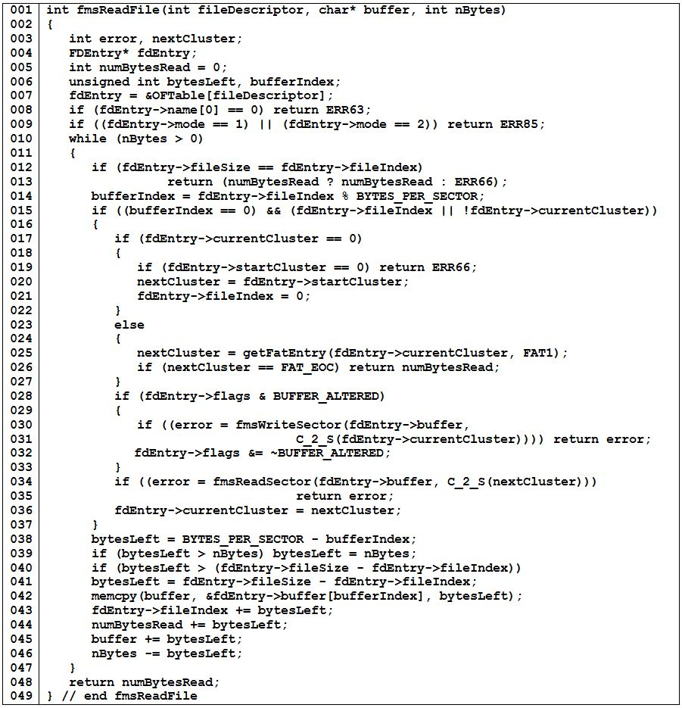

Slide 38
“Write to a File”
Errors
“File Not Open”
“Invalid File Descriptor”
“Illegal Access”
“Read Only File”
Always Writes to transaction buffer
Watch out for sector boundaries
Be lazy when writing to disk
Byte oriented (translates to cluster blocking)

Slide 39
WR command
// ***********************************************************************
// write <#>{,char}
void CL6_write(int argc, char* argv[])
{
int error, nBytes;
char buffer[4];
if (argc > 1) nBytes = INTEGER(argv[1]);
else nBytes = 1;
if (argc > 2) buffer[0] = INTEGER(argv[2]);
else buffer[0] = 'x';
buffer[1] = 0;
for (; nBytes; --Bytes)
{
if ((error = fmsWriteFile(testFID, buffer, 1)) < 0)
fmsError(error);
}
return;
} // end CL6_write

Slide 40
Copy File
LABEL(COPY); // copy file
{
int error, FDs, FDd, nBytes = 1;
DirEntry dirEntry;
char buffer[BYTES_PER_SECTOR];
// open source file
if ((FDs = fmsOpenFile(sArgs[1], 0)) < 0)
{ fmsError(FDs);
return 0;
}
// open destination file
if ((FDd = fmsOpenFile(sArgs[2], 1)) < 0)
{ fmsCloseFile(FDs);
fmsError(FDd);
return 0;
}
printf("\n FDs = %d\n FDd = %d\n", FDs, FDd);
while (nBytes > 0)
{ error = 0;
if ((nBytes = fmsReadFile(FDs, buffer, BPS)) < 0) break;
//if ((error = fmsWriteFile(FDd, buffer, nBytes)) < 0) break;
for (error=0; error<nBytes; error++) putchar(buffer[error]);
}
if (nBytes != ERR66) fmsError(nBytes);
if (error) fmsError(error);
if (error = fmsCloseFile(FDs)) fmsError(error);
if (error = fmsCloseFile(FDd)) fmsError(error);
return 0;
}
copy command:
a. fmsOpenFile
b. fmsReadFile
c. putchar(c)
d. fmsCloseFile

Slide 41
“Seek in a File”
Errors
“File Not Open”
“Invalid File Descriptor”
“File Seek Access”
“Illegal Access”
Reads correct cluster into transaction buffer
Watch out for sector boundaries
Byte oriented (translates to cluster blocking)

Slide 42
“Close a File”
Errors
“File Not Open”
“Invalid File Descriptor”
“Illegal Access”
Flushes transaction buffer
Update directory if file altered
End-of-file
Creation date/time

Slide 43
“Define a File”
Errors
“Invalid File Name”
“File Already Defined”
“File Directory Full”
Cluster allocation - demand
Allocates one cluster for directory
No clusters allocated for file

Slide 44
“Delete a File”
Errors
“Invalid File Name”, “File Not Defined”
Files
Reallocates clusters in FAT1
Place 0xe5 in directory entry(s)
Directory
No files or sub-directories
Same as for file deletion

Slide 45


